Slide 1
Challenges in relation to developing AI models and application interactions
Trenton Chramosta
UNK Alumni
Cybersecurity Engineer @NebMed
Adjunct Faculty @UNK

Slide 2
Tea and crumpets
Notes:
https://www.youtube.com/watch?v=rt1nlqJP2Ls

Slide 3
What is Artificial Intelligence?
Artificial Intelligence is a concept/idea.
There are many models and methodologies that emulate Artificial Intelligence in some shape or form.
No “one size fits all” solution
This is a fluid and evolving field with models and methodologies everywhere
Automatons/Robotics
Machine Learning
“Neural Networks”
Machine Vision
ChatGPT, Prompt engineering

Slide 4
The core of Artificial Intelligence
At the end of the day: the models and methodologies for AI are just flavors of software development.
Which means the developers/engineers creating AI related programs are the true core.
This means that common challenges everyone experiences in Software Development trickles into the sub-field of AI.

Slide 5
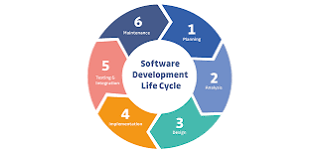
SDLC
https://medium.com/agileinsider/how-does-the-sdlc-play-a-role-in-the-success-of-product-development-and-launch-a17baaac1054

Slide 6
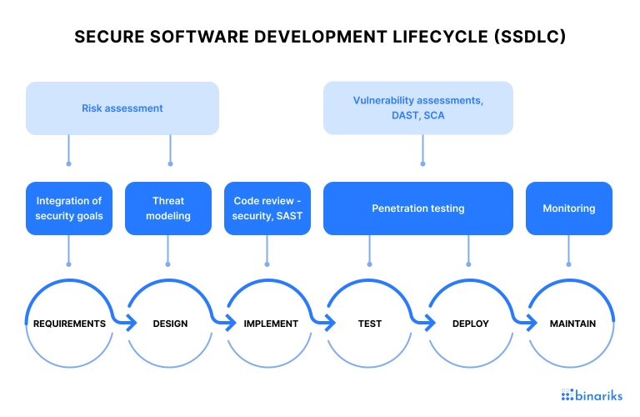
SSDLC
https://binariks.com/blog/secure-software-development-lifecycle-ssdlc/

Slide 7
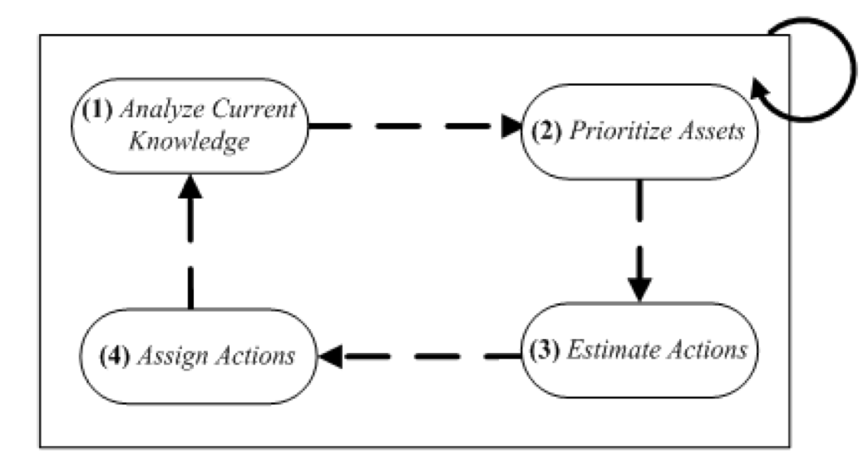
Simplified Agile Approach
Source: “Making the Response Better – Integration of Agile Approaches into Cyber Investigations”
Dr. Grispos @UNO for CYBR8490 Course

Slide 8
Practical AI Implementation

Slide 9
The “Wheel”
For your team’s course project, there is no need to re-invent the wheel.
There are AI models both free and paid that are at anyone’s disposal
Typically fall into 2 general buckets:
Software Language Libraries/Extensions
Application Programming Interfaces (APIs)
It’s all a matter of finding the right fit for your solution and “Tech Stack”
Subject Matter Experts (SMEs) can help guide
E.g., Dr. Qolomany does Machine Learning R&D and is the current UNK Cyber SME on specific Data-based Machine Learning libraries in Python

Slide 10
Language Libraries/Extensions
Language Libraries/Extensions
A mixed bag
At their best they extend functionality of a programming language and reduces complexity for the software Implementors.
At their worst, they are a bad “API in disguise” and suffer similar pitfalls to bad APIs.

Slide 11
APIs
APIs give you the ability to interface with another team/orgs code & databases via specific programming methods/functions.
There is no one true guide/framework for working with every APIs
When using an API, one is reliant on others documentation along with their own “Trial and Error” testing and documentation.

Slide 12
General API guidance
Setup stage:
Most APIs give a unique client secret, and rate limit testing. Guard this secret with your life! 🐱‍💻
Don’t expose a client secret on your remote Git Repos (public or private).
Example API and gitignore file setup
https://github.com/chramostatm/Stix-Taxi-To-EDL
Find and create good documentation and link it for future collaborators/observers

Slide 13
You are the Engineers
It’s is you and your team members responsibility to R&D your software solution and Document.
We are “Solution focused” Engineers, Curious People, and Difference Makers

Slide 14
Some Encouragement

Slide 15
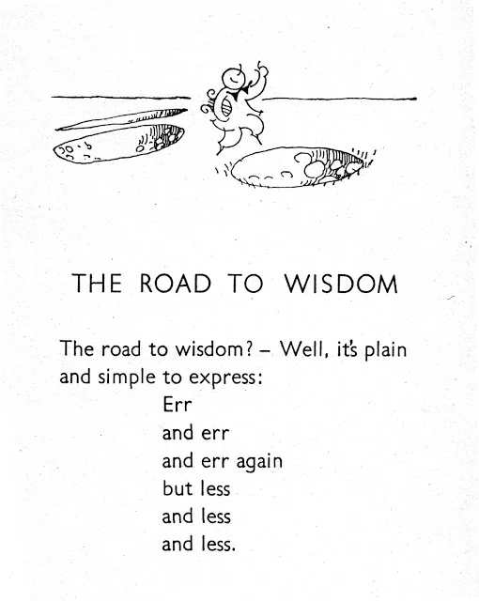


AD Astra Per Aspera
Source: Piet Hein
Source: Some Roman Guy
Source: Target/Boulevard

Slide 16
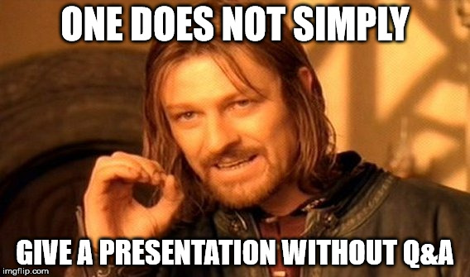
Questions?

Slide 17
Section Transition

Slide 18
1 Text box
Hi Gang!

Slide 19
2 Text boxes
Hello
World

